Slide 1

Housing Data Set
Advance Models – Group 2​​

Slide 2
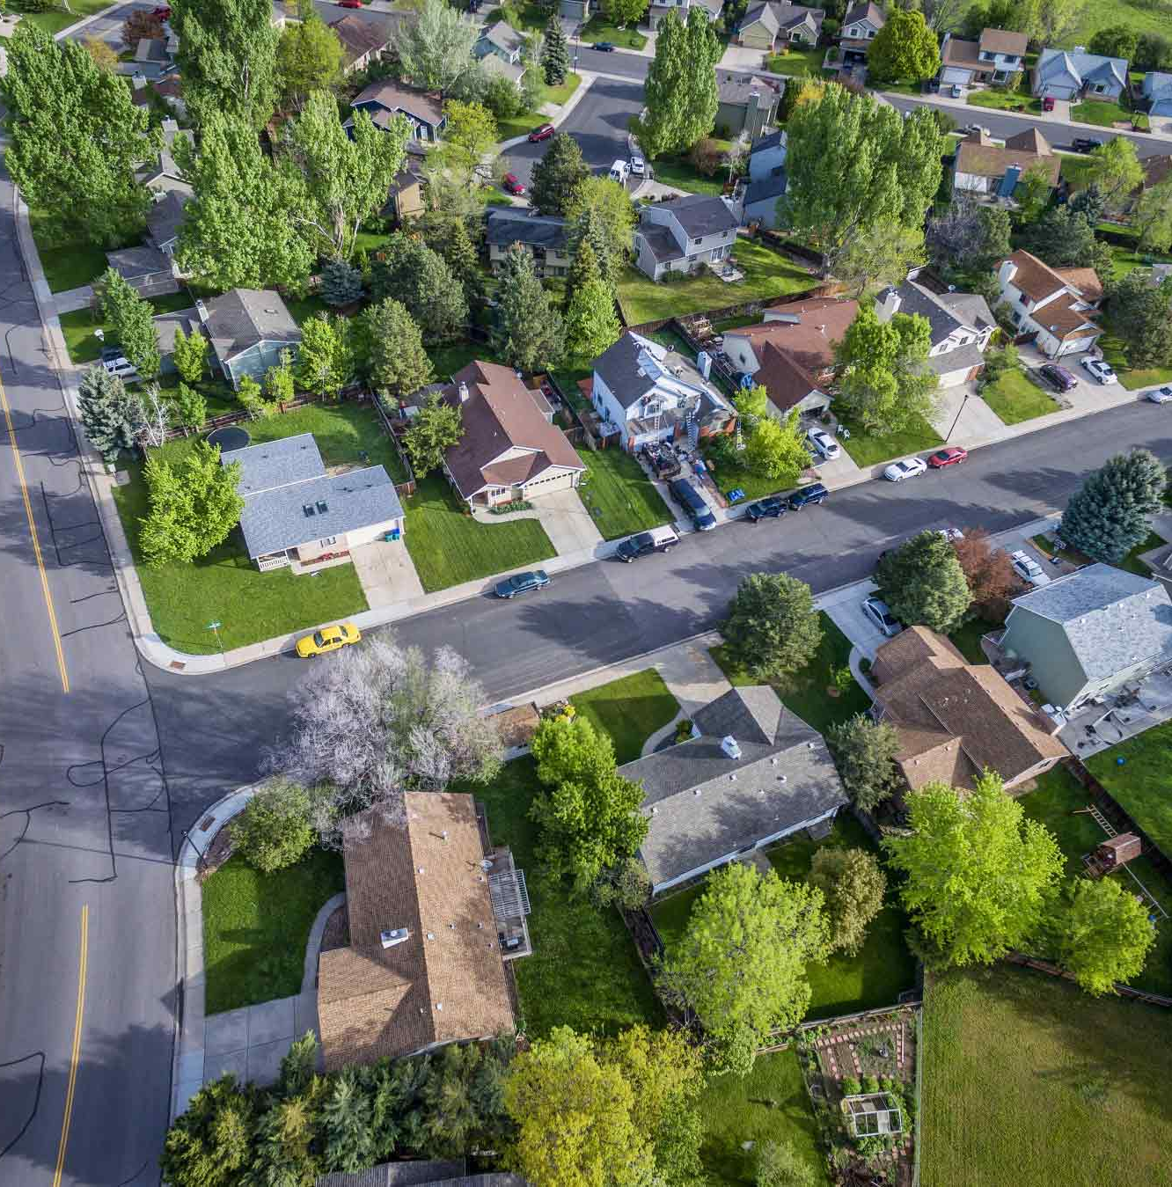
Business Question
The question
How can we help local real estate agents better predict homes in Benton County, Arkansas
Goals & objectives
Create the best predictive model​ to deliver accurate predictions

Slide 3
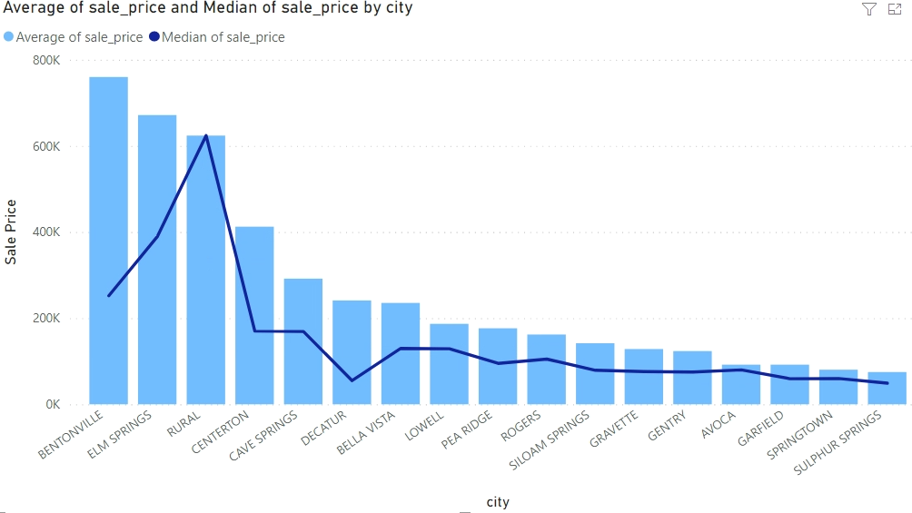
Understanding The Data
Comparing average sale price and median sale price across cities in Benton County
Across all 17 cities, average sale price ranged from ~$75,000 to ~$760,000
Significant outliers in Bentonville and Elm Springs
Notes:
﻿At $760,082.10, BENTONVILLE had the highest Average of sale_price and was 913.84% higher than SULPHUR SPRINGS, which had the lowest Average of sale_price at 74,970.49.﻿﻿ ﻿﻿
﻿﻿Average of sale_price and total Median of sale_price are positively correlated with each other.﻿﻿ ﻿﻿ ﻿﻿Average of sale_price and Median of sale_price diverged the most when the city was BENTONVILLE, when Average of sale_price were $508,082.10 higher than Median of sale_price.﻿﻿ ﻿﻿
﻿﻿Across all 17 city, Average of sale_price ranged from $74,970.49 to $760,082.10 and Median of sale_price ranged from $49,000 to $624,000.﻿﻿

Slide 4
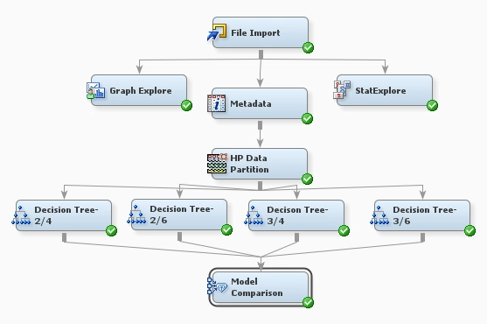
Initial Models
Decision Tree
Node Path: Metadata, Data Partition 60/40
RASE: 383119.5
Notes:
On the initial models we ran Decision Trees, KNN models and some Regression Models. The decision tree with 2 branches and a depth of 6 did give us the lowest Root Average Squared Error.
RASE on SAS was 383119.5 and then scored a 460730.8 on Kaggle.
Difference of about 77,000
This best model was then taken into advanced models…

Slide 5
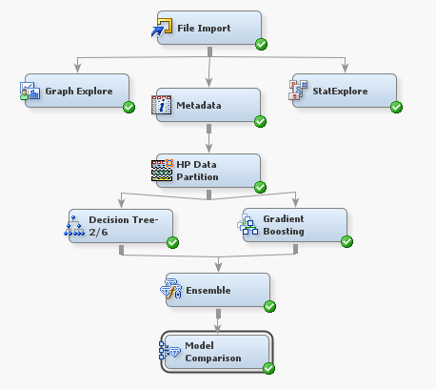
Advance Model Ensemble
Ensemble: Decision tree + Gradient Boost
Node Path: Metadata, Partition 60/40
RASE: 365362.3
Notes:
- Alright this is one of our advanced models that helped lead up to our best model.
- (2 branches, depth 6) and default settings for the gradient boost
The obyj variables rejected in file node.
The model on average can mis predict sale price by up to 365,362.3 dollars.
Now im gonna pass it off to stratton so he can talk about our best model.

Slide 6
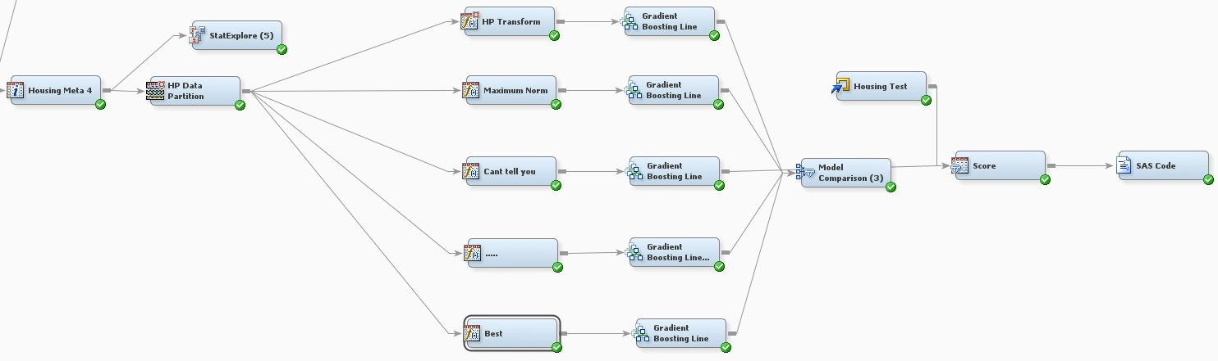
Advance Model V2
Gradient Boost
Node Path: Metadata, Partition 60/40, Transform Variables
Kaggle RASE: 332912.9
SAS RASE: 274846.1

Slide 7
Conclusion
Insufficient Model Error
Model Recommendation
Data errors
Notes:
We found several errors with the variables that jeopardize the integrity of the data.
The best model we came up with had an error output that was insufficient.
even though this is one of the best models in the region, we do not recommend this is a good model to predict housing sale prices in Bentonville.
In the end the group believes that the data needs to be reviewed for solidarity purposes. we think Until this happens the model will not be accurate enough to correctly predict sale prices for homes in the greater Bentonville area.

Slide 8
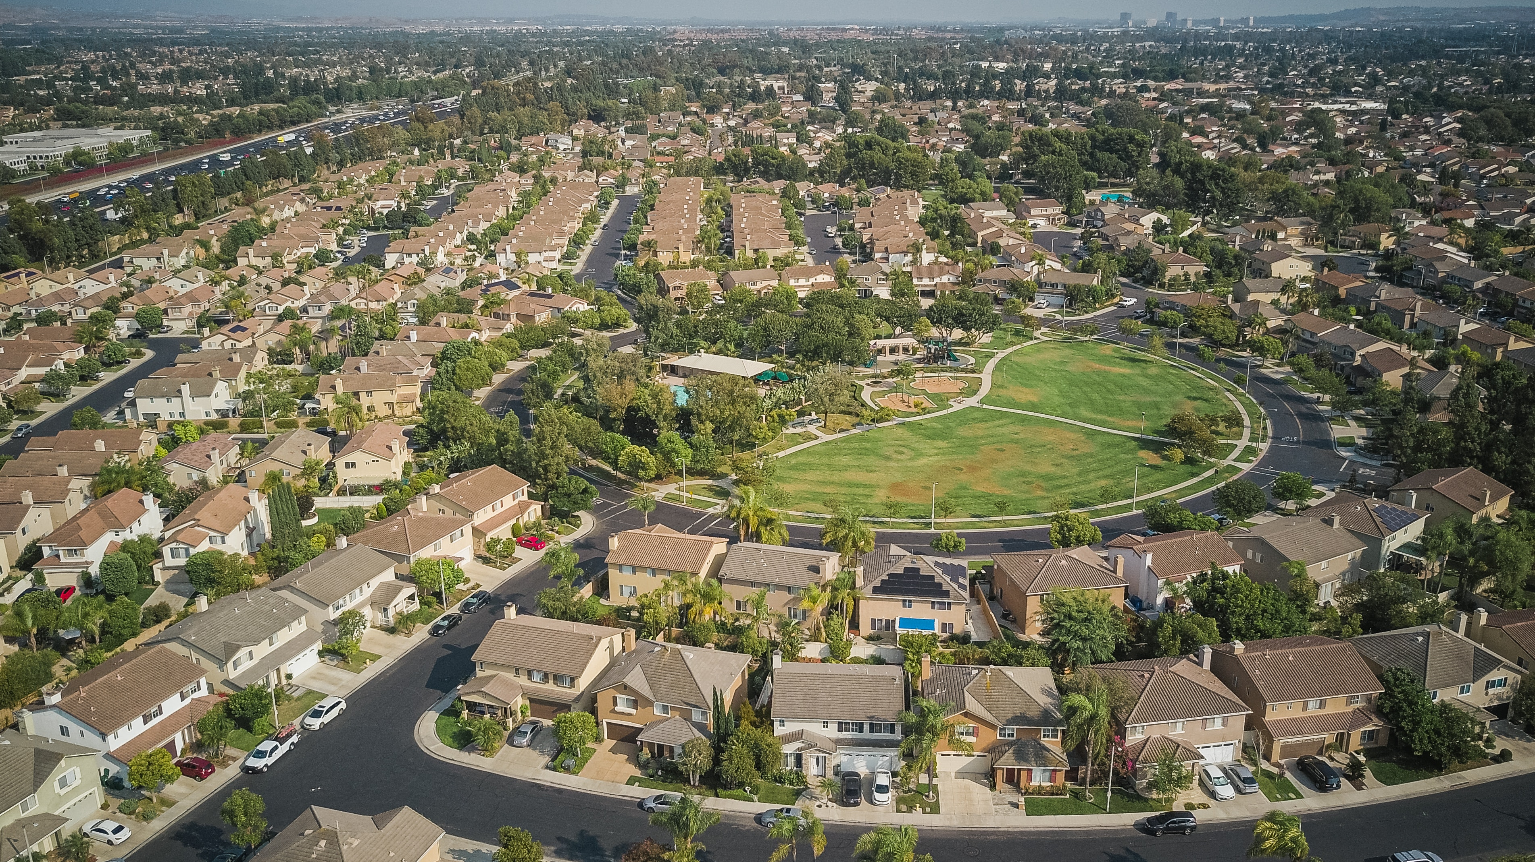
Thank you
Questions?​​

